Slide 1
Group Members:- 1. Mr. Sandip Tarachand Mohane 2. Ms. Prajakta Sanjay Bhavsar 3. Mr. Prashant Dnyaneshwar Wagh 4. Mr. Shubham Hitendra Mali 5. Mr. Hritvik Manohar Bhadane 6. Ms. Akanksha Sanjay Mahajan Guide Name madishetti rajashekhar
Domain:- Finance Project On Bankruptcy Prevention

Slide 2
When an organisation is unable to honour its financial obligations or make payment to its creditors, it files for bankruptcy.
What Bankruptcy Means ?

Slide 3
Project Objective
This is a classification project, since the variable to predict is binary (bankruptcy or non-bankruptcy). The goal here is to model the probability that a business goes bankrupt from different features.

Slide 4
Project Architecture
1. Define and understand the problem
2. Data collection
3. Data cleaning and preparation
4. Exploratory data analysis
5. Model building
6.Deployment
7.With clients to understand the requirements of a project, is to find customer is bankrupt or non bankrupt including structural elements and the overall budget.

Slide 5
DATASET DETAILS
The data file contains 7 features about 250 companies The data set includes the following variables.
1. industrial_risk : 0=low risk, 0.5=medium risk, 1=high risk.
2. management_risk : 0=low risk, 0.5=medium risk, 1=high risk
3. financial flexibility: 0=low flexibility, 0.5=medium flexibility, 1=high flexibility.
4. credibility: 0=low credibility, 0.5=medium credibility, 1=high credibility.
5. competitiveness: 0=low competitiveness, 0.5=medium competitiveness, 1=high competitiveness.
6. operating risk: 0=low risk, 0.5=medium risk, 1=high risk.
7. class: bankruptcy, non-bankruptcy (target variable).

Slide 6
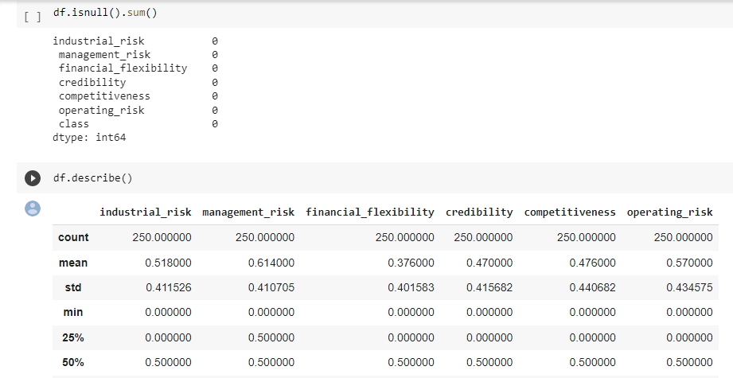
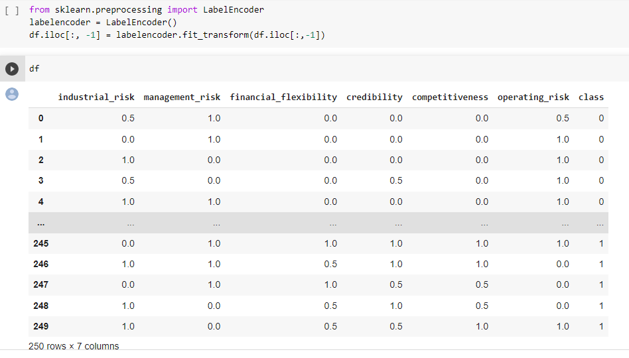
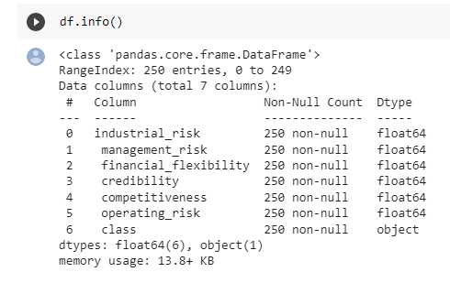
Exploratory Data Analysis (EDA)

Slide 7
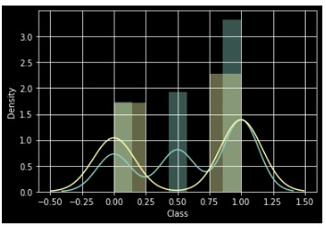
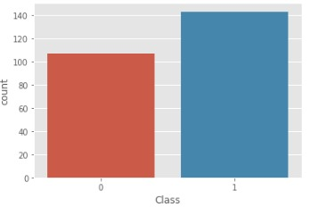
Data visualization

Slide 8
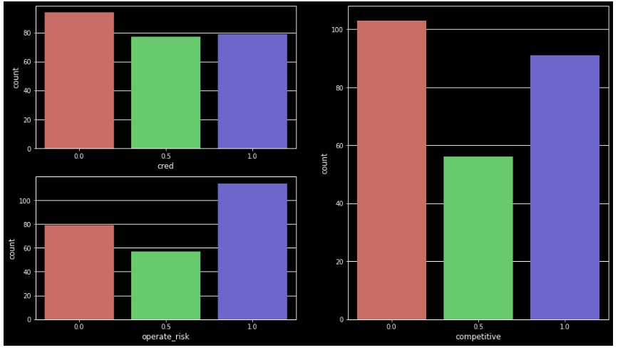
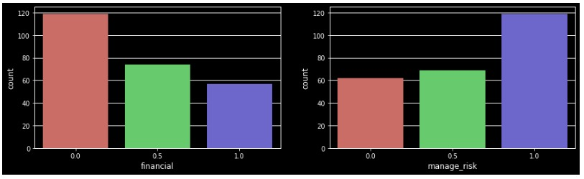
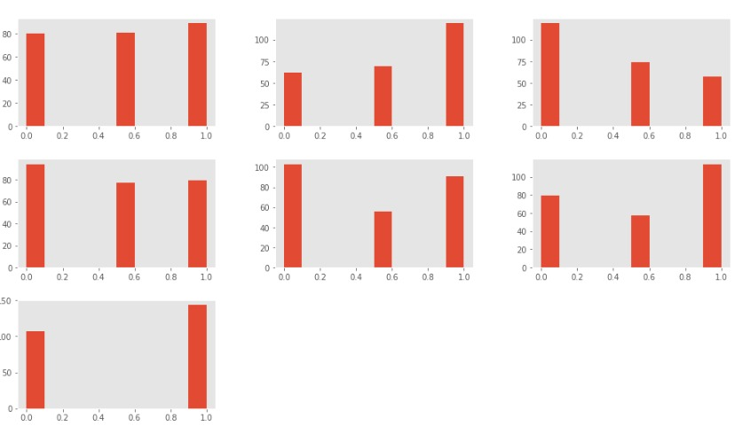
FEATURE ENGINEERING

Slide 9
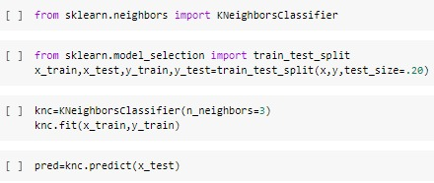
Model Building
1. Logistic Regression [LR].
2.K-Nearest Neighbour [KNN].
3.Support Vector Machine [SVM].
4.Decision Tree.
5.Naive Bayes.
K-Nearest Neighbour [KNN].

Slide 10
MODEL RESULTS
KNN algorithm gives 100% accuracy.
SVM algorithm gives 100% accuracy.
NB algorithm gives 96% accuracy.
Decision Tree algorithm gives 100% accuracy.
LR algorithm gives 100% accuracy.

Slide 11
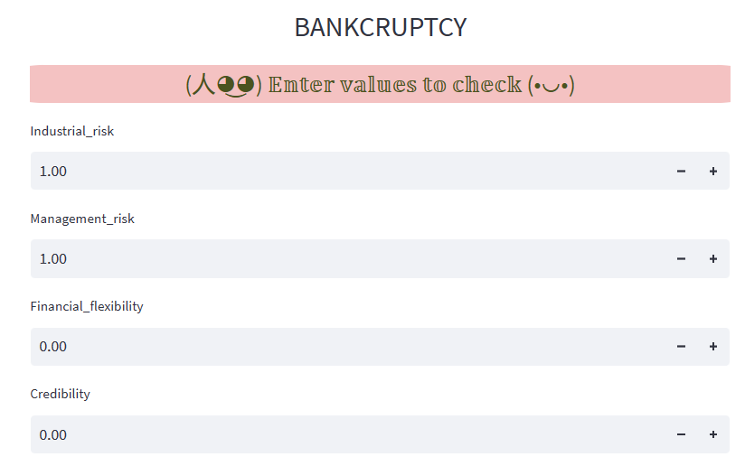
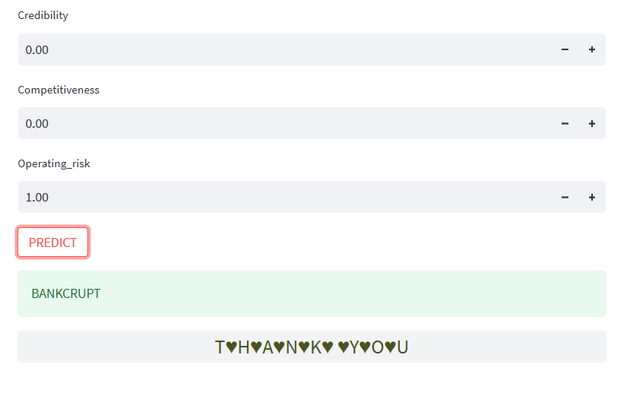
Model Deployment using Streamlit method.

Slide 12
CHALLENGES FACED How did you overcome?
There are 147 duplicate values.
Class variable was in object .
Using label encoding we changed them into 0 and 1 for better understanding.
We faced visualization issues.

Slide 13
Thank You

